Slide 1
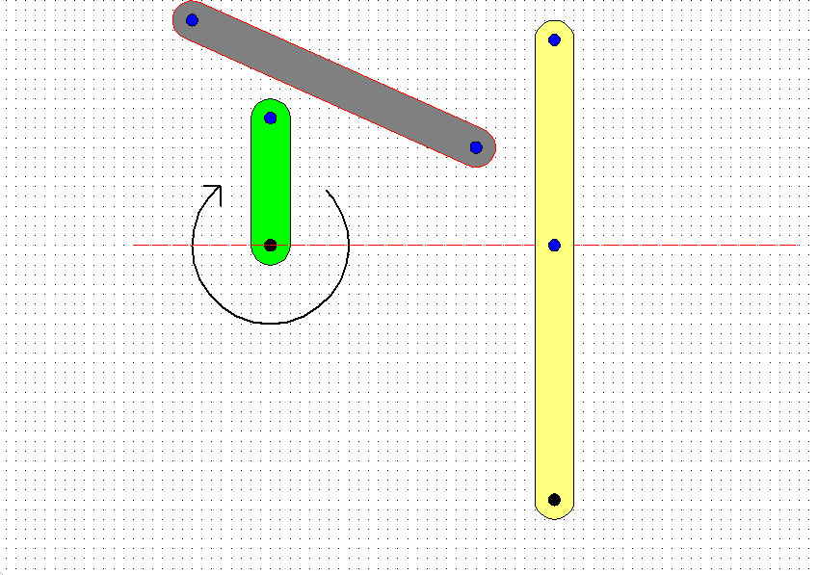
Introduction to Mechanisms
Mechanisms are used to convert rotary motion into other types of motion. You will need to know about a range of basic range of mechanisms for your Assessed Task and Final Examinations.
These are the topics you will need to know about and identify.
Linkages
Crank & Sliders
Cams x 3 Followers x 4
Yolk Cam
The Linkage Arm or Push Rod.
Basic Crank & Linkage Mechanism.
Converts Rotary Motion into Oscillating Motion.
The Crank.
The Movement Arm.

Slide 2
Introduction to Mechanisms
Moving Pivot.
Fixed & Moving Pivots.
Moving Pivot.
Moving Pivot.
Fixed Pivot.
Output Movement.
Direction of rotation of the Crank.
Fixed Pivot.

Slide 3
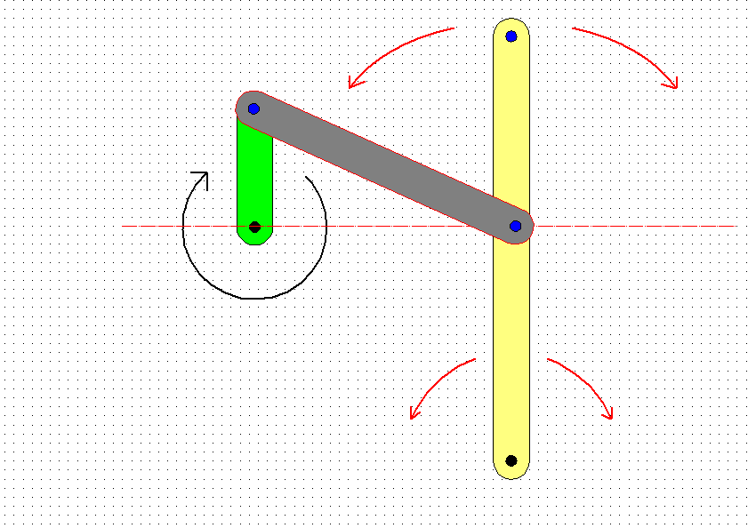
Introduction to Mechanisms
The Crank pushes and then pulls the Linkage arm.
How the Crank and Linkage Mechanism Works
The output shaft from the Gear Box turns the crank.
The Linkage Arm pushes and then pulls the Movement Arm.
The Movement Arm now oscillates around the fixed pivot.

Slide 4
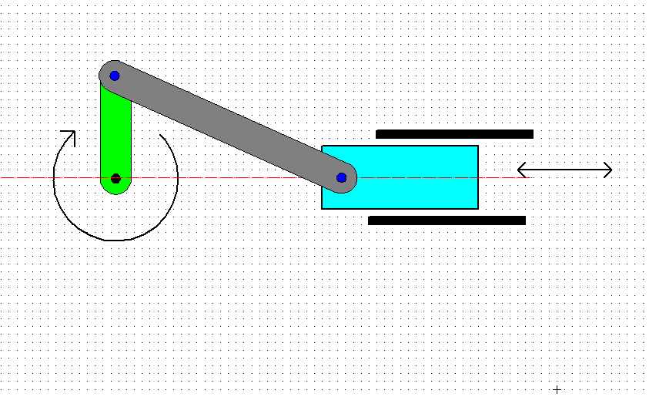
Introduction to Mechanisms
The Crank & Slider.
Converts Rotary motion into Reciprocating Motion.
The Linkage Arm or Push Rod.
Guide Rail for the Slider.
The Crank.
Direction of movement of the Slider.
The Slider.
Guide Rail for the Slider.

Slide 5
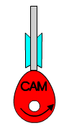
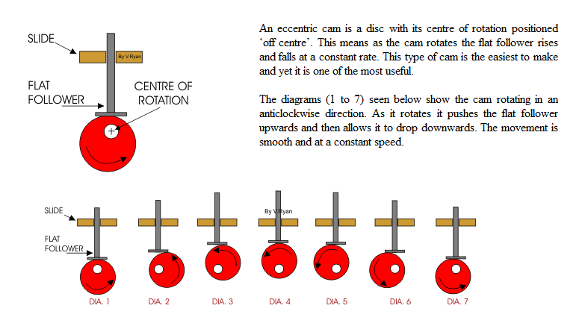
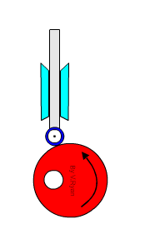
Mechanisms
There are lots of Cam profiles but you need to know about 3 particular ones.
Cams.
NOT TO BE CONFUSED WITH C.A.M
Cams are used to convert Rotary Motion into Reciprocating Motion.
The Pear Cam
The Snail or Drop Cam
The Eccentric Cam
All images from www.technology student.com
Different Cam profiles create different types of reciprocating movement.

Slide 6
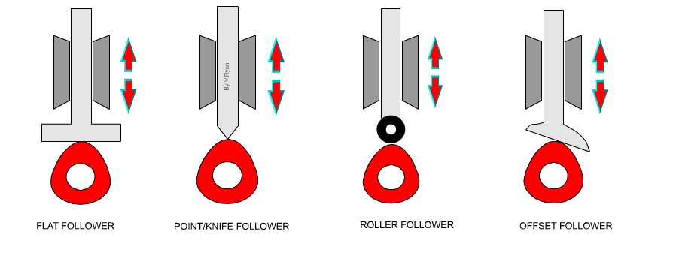
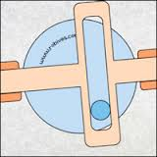
Introduction to Mechanisms
Basic Cam Followers.
image from www.technology student.com
Basic Cam Followers need something to push them back against the Cam......
Such as a spring or gravity.
Eccentric Cams & Yolk Followers.
Yolk Cam Followers can push and pull the follower without any additional parts.

